Slide 1
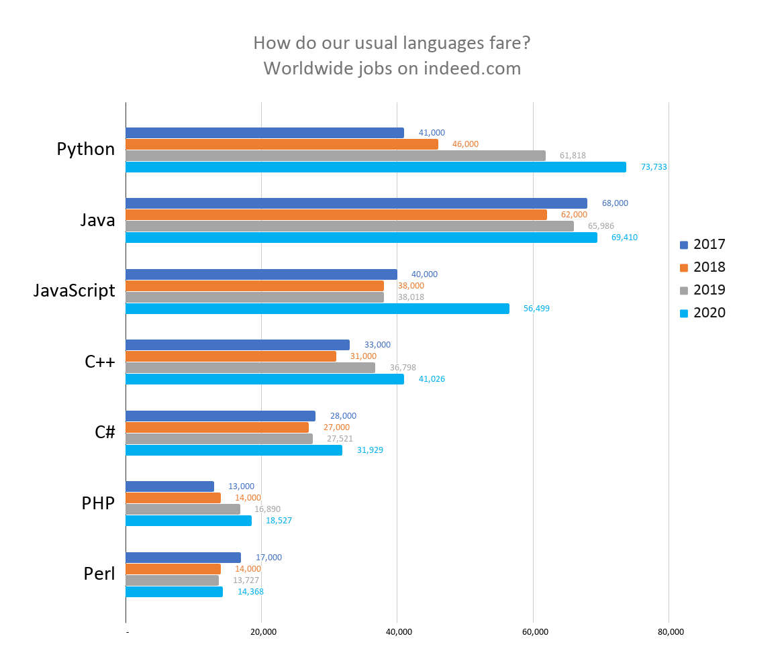

Slide 2
LINUX
LINUX Is Not UniX

Slide 3
Modern Programming Languages
Object Orientation
Functions (Methods)
Code Libraries
Event-Driven Architecture
Complex Types
Properties (encapsulation)
Namespaces
Inheritance
Overloading (polymorphism)
Identifier collision prevention
Reusability
Capture user input
Interfaces
Decoupled Code
Interfaces
Dependency injection

Slide 4
Class Libraries
.Net
Tools
Visual Studio
Visual Studio Code
Programming Language
C#

Slide 5
Sunset of the IDEs
DEVOPS
e.g. VS Code
IDE
e.g. Visual Studio
Code run in an environment that is “sort of” like production
Code run and tested in environment identical to production

Slide 6
Stages of Programming
Stage 1 – Simple programming
All code in a single block
Stage 2 – Structured programming
Code is broken functional blocks, each with a specific job and a name
Call a function when you need to do that task
Stage 3 – Object Oriented Programming
Organize data and actions around the real-world object that the code is manipulating

Slide 7

It’s all about CONTROL!

Slide 8
Graphical User Interface (GUI)
Desktop
XAML
.Net MAUI
Web App
HTML, CSS & JavaScript
Razor
Web API
Server-to-Server
No UI needed
Blazor
JS Framework (Angular, React, Vue, etc.)
Xamarin

Slide 9
Understanding an application
High-level organization
(OOP, classes, properties, methods)
Low-level details
(variables, functions, branching, looping)
Tools
Code editing
Source Code Control
PROGRAM

Slide 10
Client
Server
App
C#
REST
API
HTML, CSS and JavaScript
Client w/
Web browser
Web App
HTTP Request
Mobile device w/
app
Web Server +
OS
Mobile
App
HTTP Response
?
API App

Slide 11
HTML Web Page
Header
HTML Web Page
Header
Nav
Nav
Footer
Footer

Slide 12
Header Section
Razor Layout
Nav Section
Content Partial Page
Content Partial Page
Content Partial Page
Content Partial Page
Footer Section

Slide 13
10975 - Refactor ReadLine method
// Ask the user to type the first number.
Console.WriteLine("Type a number, and then press Enter");
string temp = Console.ReadLine();
num1 = Convert.ToInt32(temp);
// Ask the user to type the first number.
Console.WriteLine("Type a number, and then press Enter");
num1 = Convert.ToInt32(Console.ReadLine());

Slide 14
Save All
Build (compile) code
Load app on IIS Express (MS Web Server) and assign port
Opens browser and goes to localhost:port for app
Visual Studio
Start with or without debug

Slide 15
Managed Code
Build/Compile
Intermediate Language
C#
Machine Code
CLR
Visual Basic
F#
Assembly
(.dll or .exe)
Unmanaged Code
Other Compiled Code

Slide 16
int x = 2;
int x = y;
int x = x+y;

Slide 17
myNum - camel case
MyProp - Pascal case

Slide 18
Definition of method
MethodName(param1, param2, …)
Value in program
Using method
MethodName(argument1, argument2, …)

Slide 19
Definition of method
SetAppointment(owner, datetime, …)
Value in program
Value in program
Using method
SetAppoint(DeVries, 7/7/2020, …)

Slide 20
DataBase
User 1
Edit X
User 2
Edit X
User 1 changes X to X1
User 2 changes X to X2
User 1
Write X1
User 2
Write X2

Slide 21
DataBase
User 1
Edit X
User 2
Edit X
User 1 changes X to X1
User 2 changes X to X2
User 1
Write X1
User 2
Write X2

Slide 22
Default Route
http://mydomain.com/home/index/id?

Slide 23
Bubble Sort
2
3
5
6
8

Slide 24
Bubble Sort
Student2
Student3
Student5
Student6
Student8

Slide 25
List
Dictionary
Value
Key
Value
3
Monday
3
5
Tuesday
5

Slide 26


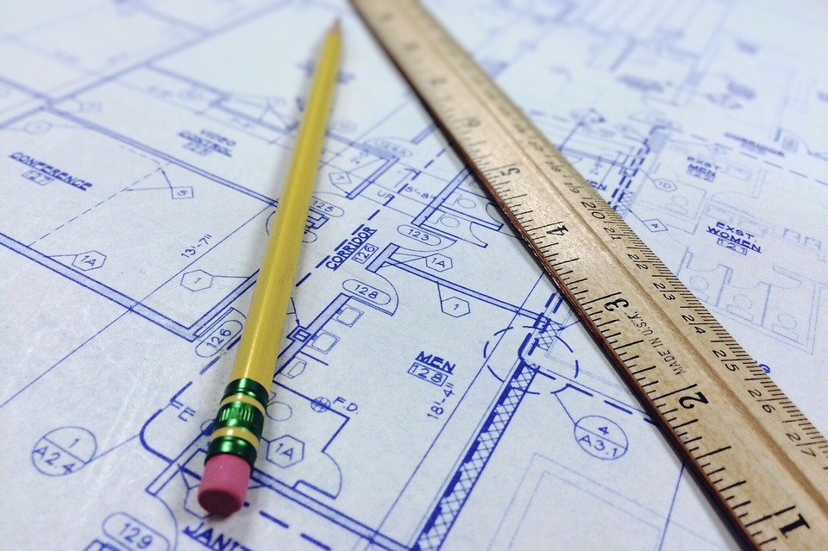
Object (executable)
Type: Bungalow1
Constructor
Class (description)
Class Name: Bungalow1
instantiation
Properties
Methods
Constructor
Other

Slide 27
Members of a Class
Fields are local scope variables in a Class
Properties hold data in memory
We call classes that are mostly Properties “models”
Methods perform actions on data

Slide 28
Class CreditCourse
{
int courseId;
string courseName;
int courseLength;
CreditCourse()
{
}
}

Slide 29
Complex data type
variable
constructor
CreditCourse creditCourse = new CreditCourse();
or creditCourse1
or foo
or var
Specify data type
Of variable
Assign to
variable
Creates a new instance of class (object)

Slide 30
Working with an external service
External Service
(File or DB or Network or …)
In-Memory Proxy for External Service
(Client or Context Object)
Your Code

Slide 31
Consuming a Class Library
Define Classes and/or Methods as “static”
Do not need to be instantiated, you just use them
Instantiate an Object from the Class library
Inherit the Base Class from the Class library
Extend it to customize for your application

Slide 32

House
This Photo by Unknown Author is licensed under CC BY-NC
Interface Door( H , W)

Slide 33
House
This Photo by Unknown Author is licensed under CC BY-NC
Interface Door (H , W , T, LorR, weight)

Slide 34
Dog
-Breed
Abstract Base Class
Pet
:
Cat
Reptile
-Owner
-Name
-DoB
-Weight
…
(-Species)?
Bird
Fish
- Fresh or salt water

Slide 35
Vet Practice App
Class Animal
Class Appointment
Action | Class | Method
Register new owner | Owner | CreateNewOwner
Assign a vet to a pet (optional) | Pet | AssignVet
Register pet | Pet | RegisterPet
Make an appointment | Appointment | CreateAppt
Cancel appointment | Appointment | CancelAppt
Change appointment | Appointment | ChangeAppt
Make pet inactive | Pet | MakeInactive
properties
properties
Methods
Constructor
RegisterPet
AssignVet
Methods
Constructor
CreateAppt
CancelAppt
ChangeAppt
Class
Vet
Class
Owner
properties
properties
Methods
Constructor
Methods
Constructor
CreatNewOwner

Slide 36
Class Properties
Complex Data Type
Class Animal
{
string PetName
string Owner
char Gender
datetime DoB
int AmountOfFood
string BloodType
list Medications[]
string Species
float Height
float Weight
bool Spayed/Neutered
}

Slide 37
OS:
Windows or
Linux or
MacOS
Program executing in memory
Create a file
Open a file
Read from file
Write to file
I/O
File on HDD
Code
Stream
I/O
File on SSD
File on SAN
I/O
Abstraction
I/O
File on Cloud Storage

Slide 38
Memory
Variable
Pass by reference
variableName = 5
Int variableName
Copy of variable
Pass by value
variableName = 5

Slide 39
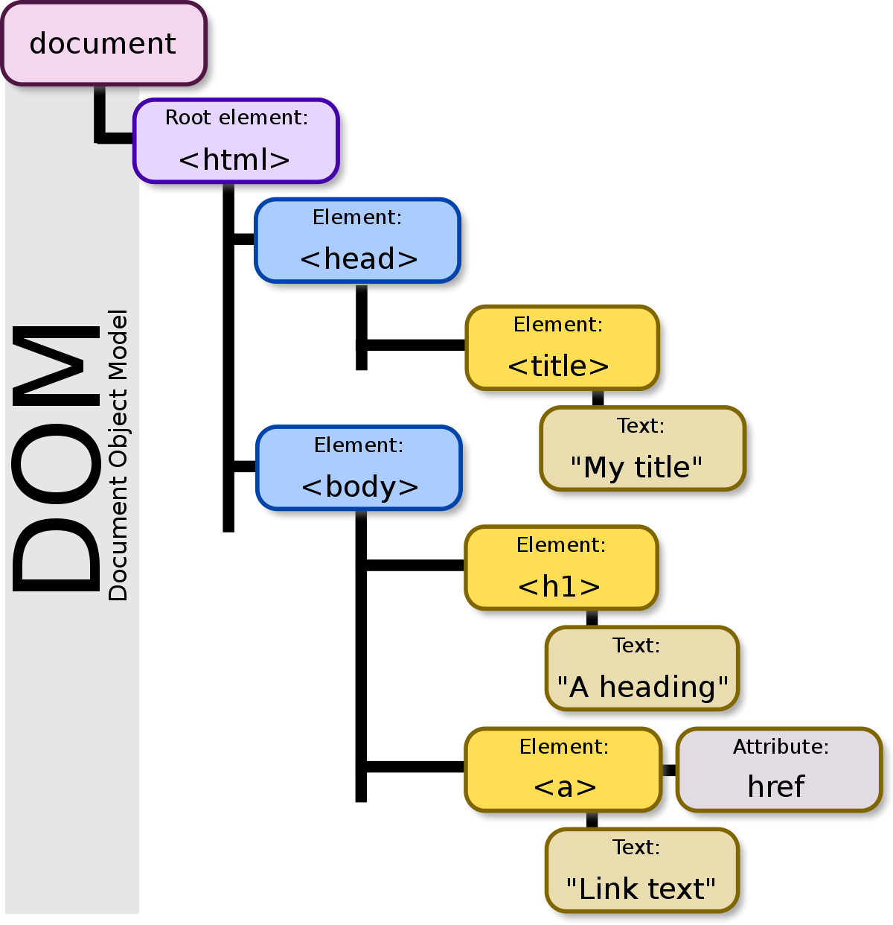

Slide 40
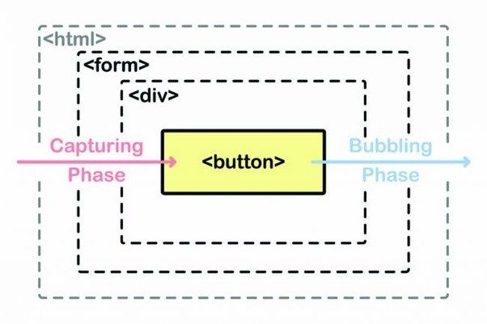

Slide 41
Variable
x=1
x=3
x=2
Should be 3
A Read
B Read
x=x+2
A Write
x=x+1
B Write

Slide 42

Without Dependency Injection
AutoFactory
EngineFactory
Tight coupling
New EngineFactory()
Robot
WaterPumpFactory
SteelCastingFactory

Slide 43
With Interface
AutoFactory
Loose coupling
EngineFactory
IEngineFactory
Robot

Slide 44
With Interface
AutoFactory
Loose coupling
EngineFactory
4 cylinder
IEngineFactory
Robot
EngineFactory
6 cylinder
FakeEngineFactory
6 cylinder

Slide 45
With Dependency Injection
ConfigureServices()
Auto Factory
Engine Interface
Engine Factory
Injection
Robot
Tire Interface
Tire Factory
Injection
Window Interface
Window Factory
Injection

Slide 46
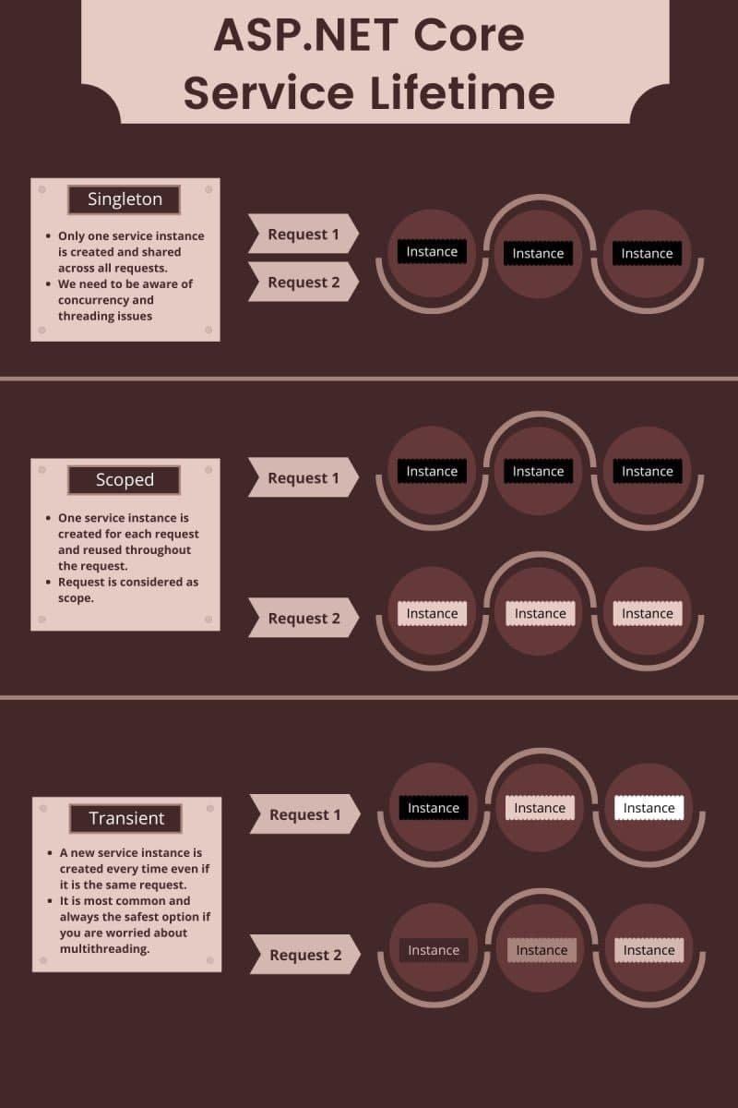

Slide 47
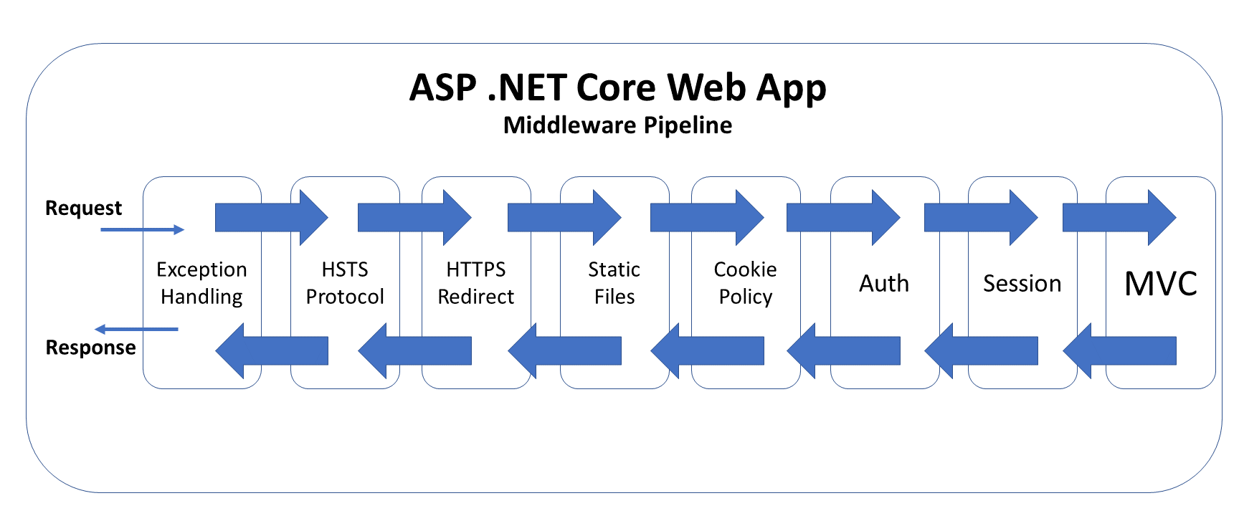

Slide 48
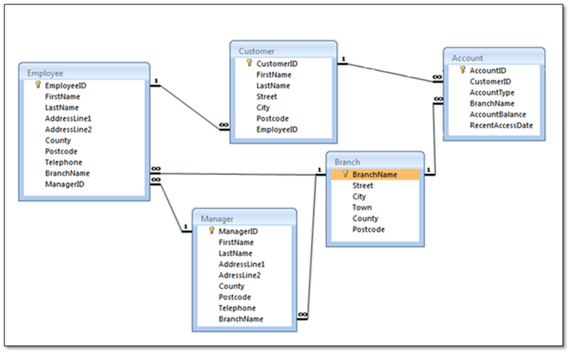

Slide 49
Class: Person
Property: ID
Property:FirstName
…
Object: Person1
Table: Person
ID | FirstName | LastName | DoB
Object: Person2
Object: Person3

Slide 50
.Net Program
Relational Database
Cache
Provider
Table1
Field1
Field2
ADO.Net
DataClass1
Prop1
Prop2
LINQ
Entity Framework
Data
Class 2

Slide 51
Program
myContext:DbContext
Database
Read
DBSet

Slide 52
Program
Your code
Database
myContext: DbContext
DBSet
SaveChanges()
Write

Slide 53
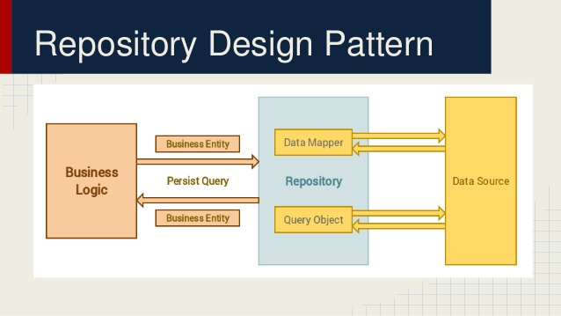

Slide 54
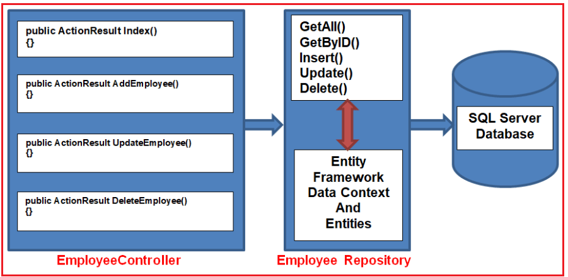

Slide 55
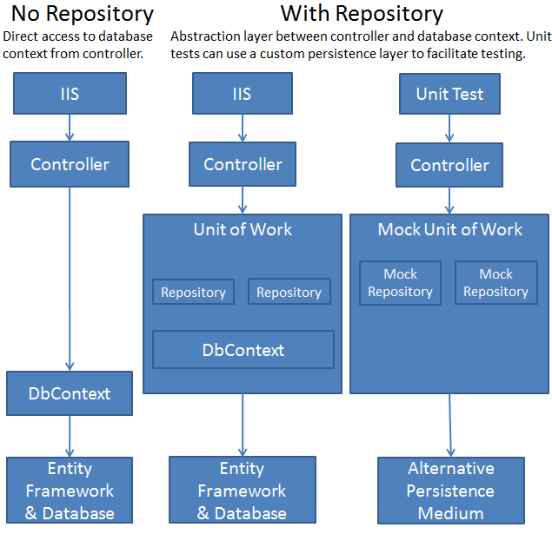

Slide 56
Classes
Tables
User
User
Student
Teacher
TPT
Student
Teacher
User | Student or Teacher | Username | Password | …
TPH
Student
Teacher
TPC

Slide 57
Explicit Loading
vs
Lazy Loading
vs
Eager Loading
Database
Code
DB Query
Query Results
Books
Table
Authors
Table

Slide 59
Web or Mobile App
Your Controller Class:
MyController
Base Class:
Controller
Base Class:
ControllerBase
:
:
Adds support for Views
API App
Your API Controller Class:
MyApiController
Base Class:
ControllerBase
:

Slide 60
UI Issues
Dynamic Data
Data Binding
Page Composition
Create page from reusable pieces
Event Handling
Event Object
Event source
Event properties

Slide 61
Load Balancer
Redis
Cache
App Instance 1
App Instance 2
App Instance 3

Slide 62
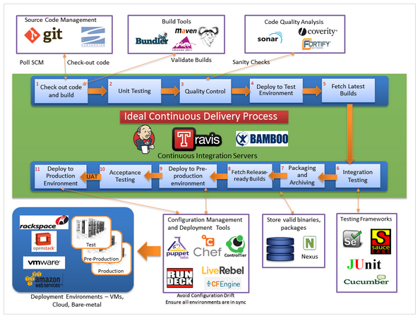

Slide 63
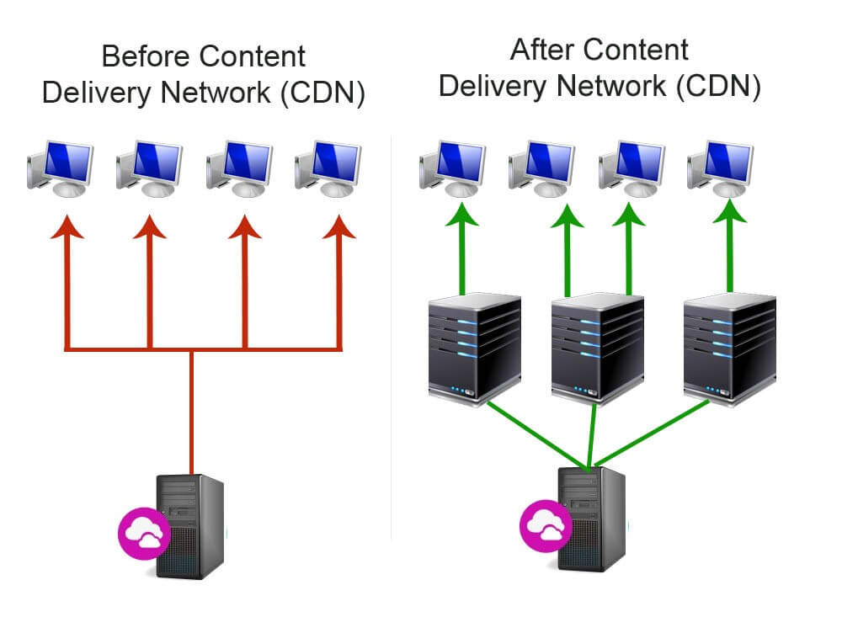

Slide 64
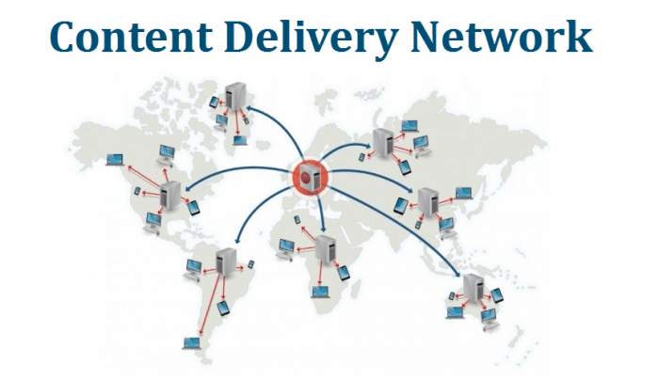

Slide 65
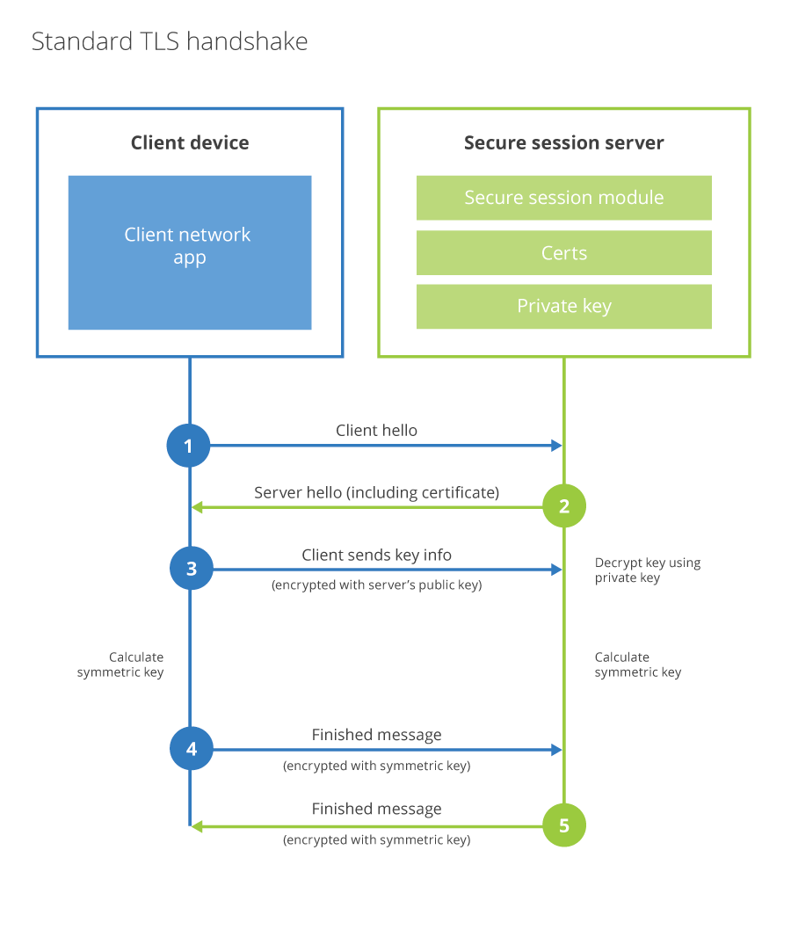

Slide 66
Websockets
Client
Server
App
REST
API
Normal HTTP Loop
Client w/
Web browser
Client contacts server
Client w/
Web browser
Web App
Websocket
Web Server +
OS
Client w/
Web browser
Server contacts client
Client w/
Web browser
Web App
Was setup in advance

Slide 67
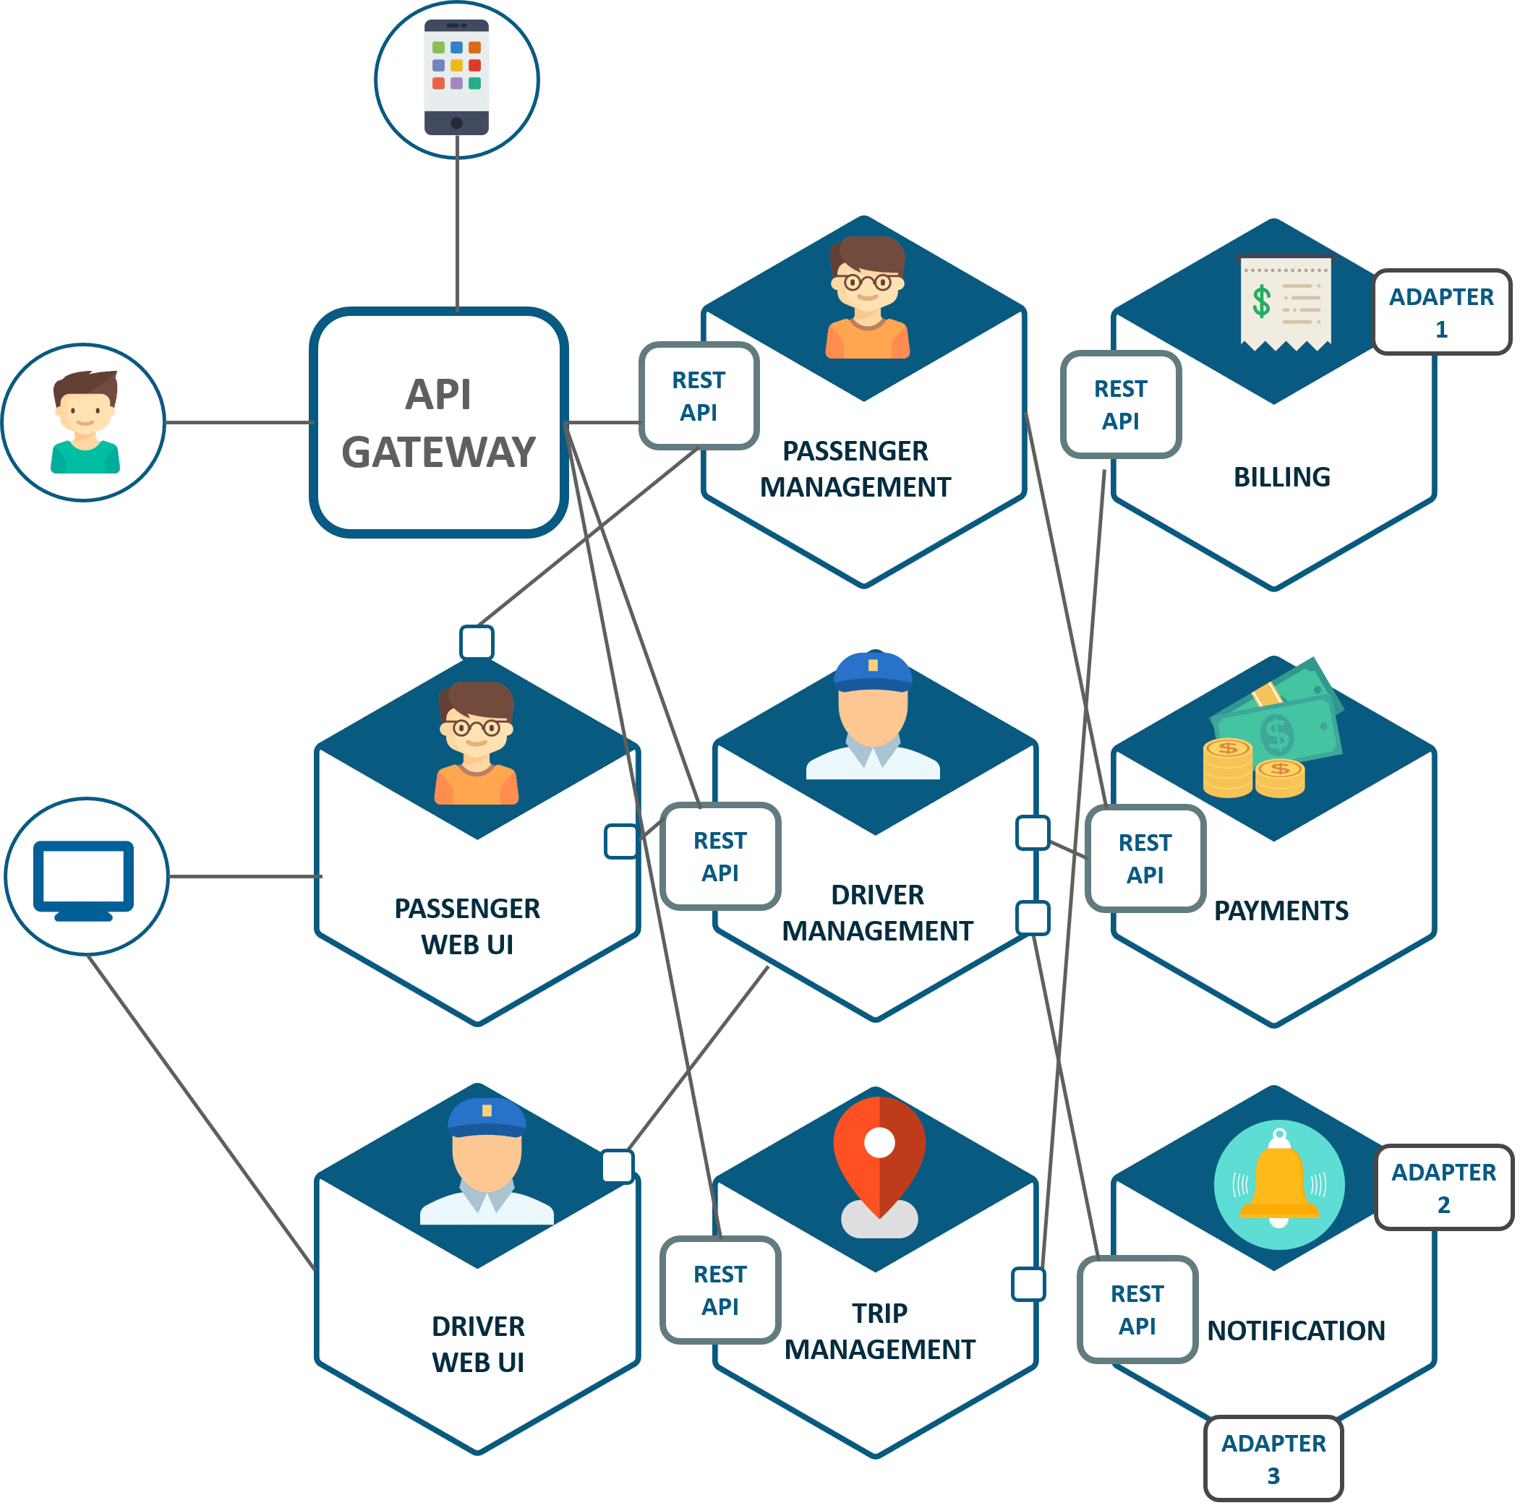

Slide 68
AddNums (a,b)
sum=a+b
return sum
AddNums (a,b,c)
sum=a+b+c
return sum
AddNums (a,b,c,d)
sum=a+b+c+d
return sum

Slide 69
Event Generator
Event Listener
Event object
Event
object
Event Handler

Slide 70
Main_entry
Method1
Method2
Method3
method4
Garbage Collector
Scope
Scope
Scope
Scope
Scope

Slide 71
Client
Server
App
REST
API
Client w/
Web browser
Web App
HTTP
AzureAPI
Mgmnt
Mobile device w/
app
Web Server +
OS
Mobile
App
HTTP
?
API App
HTTP

Slide 72
Memory
Reference Type
Variable x
y = x
Value Type
copy
Variable b
a = b

Slide 73
Memory
Reference Type
Variable x
reference
Value Type
copy
Variable y

Slide 74
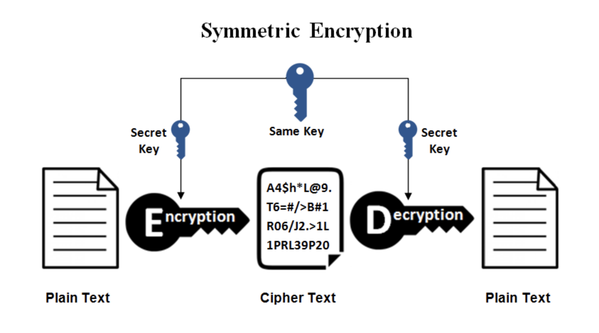

Slide 75
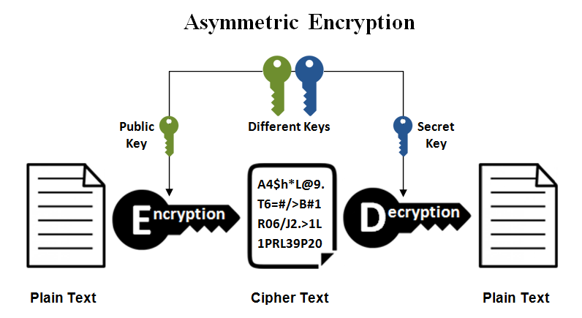

Slide 76
C# Resources
C# Tutorial (C Sharp) (w3schools.com)
C# Coding Conventions - C# Programming Guide | Microsoft Docs
Visual Studio IDE, Code Editor, Azure DevOps, & App Center - Visual Studio (microsoft.com)
.NET | Free. Cross-platform. Open Source. (microsoft.com)
.NET documentation | Microsoft Learn
.NET developer community | Connect with like-minded developers (microsoft.com)
.NET API browser | Microsoft Docs
C# Fundamentals for Absolute Beginners | Channel 9 (msdn.com)
Free ebooks for .NET & JavaScript Developers | Syncfusion
Amazon.com: Rockin the C# Interview: 2017 Edition: A comprehensive question and answer reference guide for the C# programming language. eBook: Unger, Greg: Kindle Store
Learning C# by Developing Games with Unity 2020 - Fifth Edition | Packt (packtpub.com)
https://www.dotnetcurry.com/

Slide 77
C# Tutorials
.NET In-Browser Tutorial - Step 1: Intro (microsoft.com)
Introduction to C# - interactive tutorials | Microsoft Docs
https://docs.microsoft.com/en-us/dotnet/core/tutorials/with-visual-studio
https://docs.microsoft.com/en-us/dotnet/core/tutorials/with-visual-studio-code
350+ C# Practice Exercises // Edabit

